Slide 1
函数式语言与并行计算 - SIMD 2017 U8平台“自学互学”系列讲座
2017-04-27,yl

Slide 2




0-1 函数式语言
C#
Scala
Orleans
Kafka
Notes:
编程范式(Programming paradigm)有几十种，这里列出的仅仅是主流的几种

Slide 3
0-2 并行计算
并行计算
显式并行
任务并行
细粒度并行
指令并行
Mult-Core
Many-Core
Super Scalar
Mult-Threading
OOO/RISC
SMP，NUMA
CUDA
结构化并行
SIMD
OpenCL
OpenMP
EPIC
Task / PLINQ

Slide 4
01
SIMD
02
SIMD with C++
03
SIMD with C#
Notes:
这是今天答辩的提纲

Slide 5
1-1 Flynn’s Taxonomy(弗林分类法）
1966 年 Michael Flynn 所提出的计算机体系结构的分类体系
基于两个特征分类
Parallelism exhibited with its instruction streams
Parallelism exhibited with its data streams
Four distinct classifications
SISD / SIMD
MISD / MIMD

Slide 6
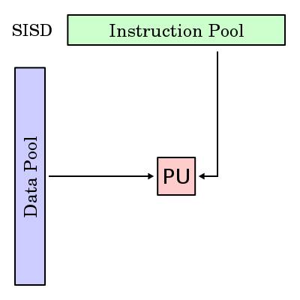
1-2 SISD – Single Instruction Single Data
Single CPU systems
Specifically uniprocessors
Co-processors do not count.
Concurrent processing
Pipelined execution
Prefetching
Concurrent Execution
Independent concurrent tasks can execute different sequences of operations
Examples
Personal computers

Slide 7
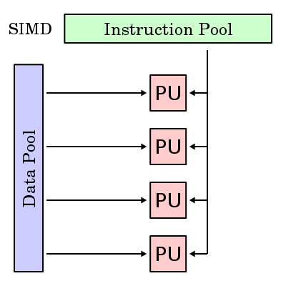
1-3 SIMD – Single Instruction Multiple Data
One instruction stream is broadcasted to all processors
In reality, that processor will be simple, such as an ALU (Arithmetic Logic Unit)
All active processors execute the same instructions synchronously, but on different data
The data items are aligned in an array (or vector)
An instruction can act on the complete array in one cycle
Examples later on

Slide 8
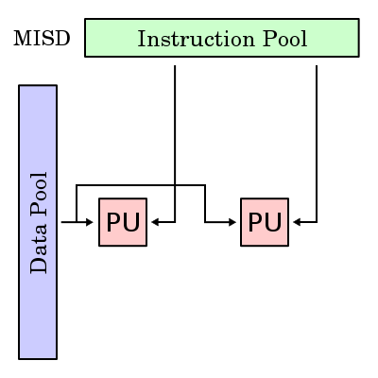
1-4 MISD – Multiple Instruction Single Data
Uncommon architecture type that is used for specialized purposes
Redundancy
Fault Tolerance
Task replication
Example
坦克
航天飞机飞行控制系统

Slide 9
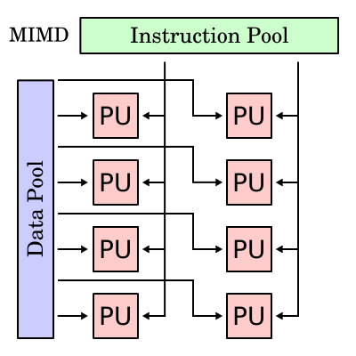
1-5 MIMD – Multiple Instruction Multiple Data
基于我的见识，
这只是一种理论存在

Slide 10
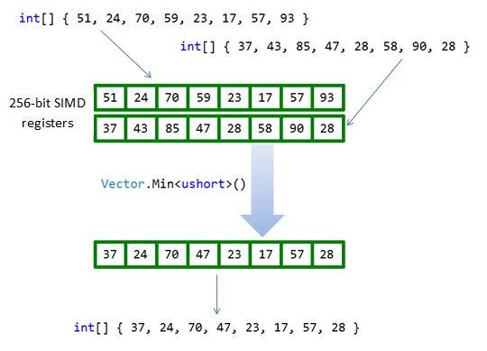
1-5 MIMD – Multiple Instruction Multiple Data

Slide 11
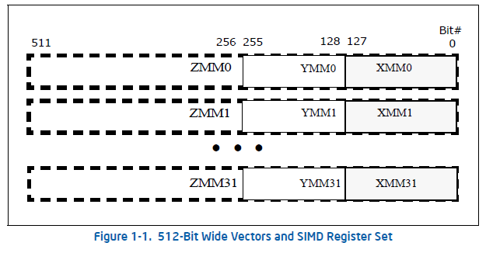
1-7 AVX 512
操作系统在切换线程时，需要把CPU寄存器保存到内存，然后在
AVX512的寄存器现场比过去大，Win7要改最核心的内核代码才能支持AVX512，但微软放弃了升级Win7/8.
需要 Win10才能支持AVX512

Slide 12
1-6 SIMD 与当今处理器
Year | Extension | Register Size
1997 | MMX | 64 bits
1999 | SSE | 128 bits
2001 | SSE2 | 128 bits
2004 | SSE3 | 128 bits
2006 | SSE4 | 128 bits
2008 | AVX | 256 bits
2015 | AVX-512 | 512 bits
ARM v6 v8（Advanced SIMD）
Power / UltraSPARK

Slide 13
01
SIMD
02
SIMD with C++
03
SIMD with C#

Slide 14
2-1 SIMD C++ 编译环境
Windows 8.1
函Visual Studio 2013
Visual Studio 2013 features
auto-vectorization which I have turned off

Slide 15
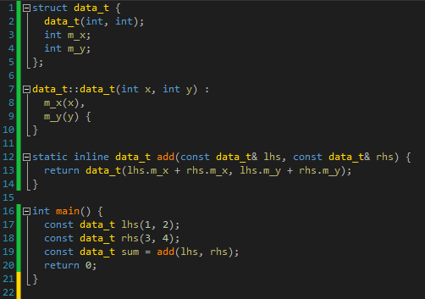
2-2 C++ SISD(Scalar)

Slide 16
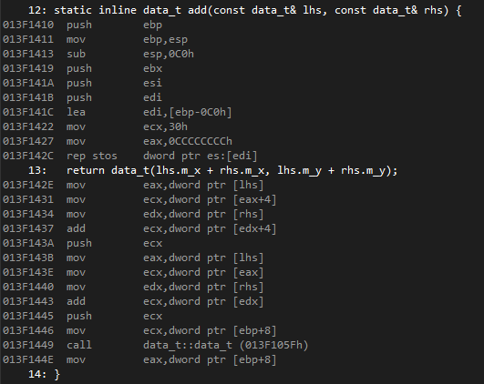
2-2 C++ SISD(Scalar),disassambly

Slide 17
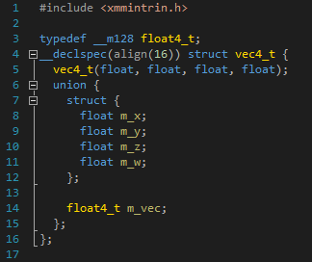
2-3 SIMD Simple Program Source, Part 1
Definition of vec4_t
The xmmintrin.h header gives the programmer access to intrinsic types and intrinsic operations
There is an alignment requirement to store all four 32 bit floating point values in a 128 bit (or 16 byte) aligned intrinsic type
A four dimensional vector is composed of x, y, z, and w components

Slide 18
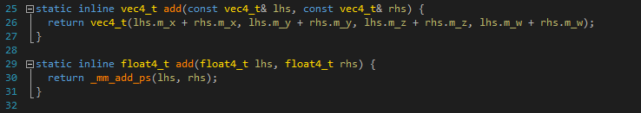
2-4 SIMD Simple Program Source, Part 2
Both functions compute addition of two four dimensional vectors
The first function uses normal SISD instructions to do so, similar to our first SISD example
The second function uses _mm_add_ps, which is an intrinsic function that consumes two m128 types, does parallelized component addition using SIMD, and returns the resulting m128 type
As shown in the first function, we typically pass objects by const reference to function parameters for read operations. But with SIMD, the cost of indirection through references is ill-advised. It is cheaper to copy the values.

Slide 19
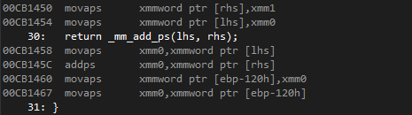
2-5 SIMD Simple Program Disassembly, Part 2
Disassembly of function add (SIMD)
Immediate storage into SIMD registers
A single, parallelized add operation using addps

Slide 20
01
SIMD
02
SIMD with C++
03
SIMD with C#
Notes:
这是今天答辩的提纲

Slide 21
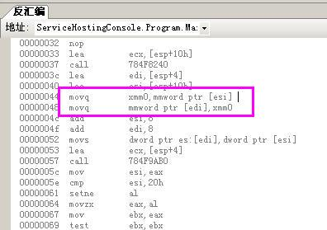
3-1 SIMD in JIT(即使没有使用Vector)

Slide 22
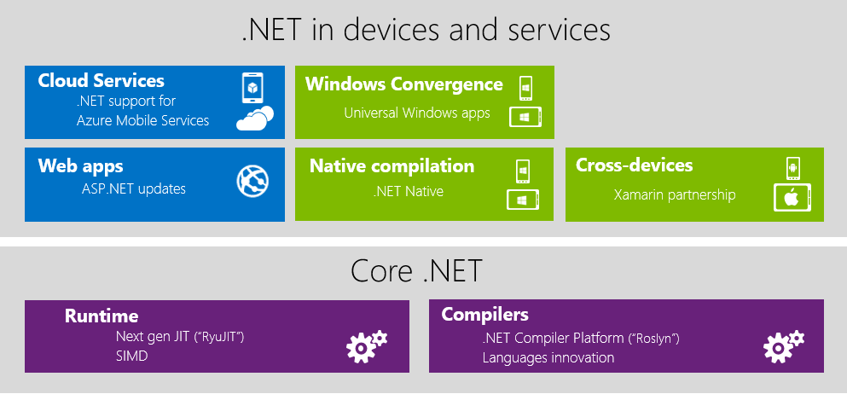
3-2 SIMD C# 需要的运行环境有使用Vector)
.net core 1.0 / .net framework 4.6
.net 4.5.2 内置 RyuJIT 但此隐藏功能需要修改注册表打开。
X64时真正开启硬件加速，X86保证逻辑正确但性能比不加速还低

Slide 23
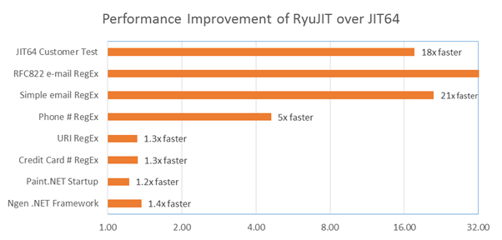
3-3 RyuJIT 性能暴增

Slide 24
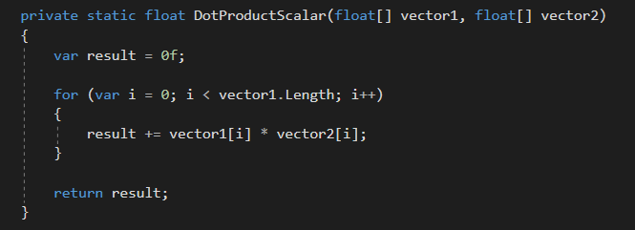
3-4 计算向量的内积（Scalar标量版）

Slide 25
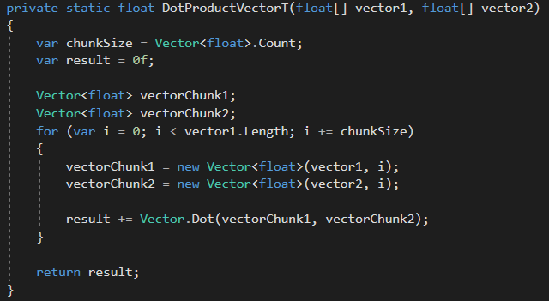
3-5 计算向量的内积（Vector向量版）

Slide 26
3-7 性能比较
Method | 向量化 | 计算时间
Scala | 1 | 8.43秒
Vector<float> | 8 | 2.62秒
计算10,0000维向量内积
Intel i3-4360 @ 3.7GHz
Win10

